Slide 1

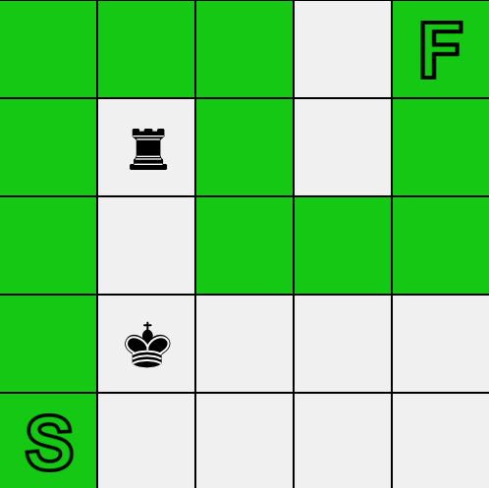
Chess Snake IART Project- Final Delivery
Carlos Gomes – up201906622
Domingos Santos – up201906680
Filipe Pinto – up201907747

Slide 2
Specifications
The main goal for this project is to, based on Artificial Inteligence skills and search algorithms, implement a version of the puzzle “Chess Snake”;
The main goal of the puzzle is to connect the bottom left tile of the board with the top right tile, by creating a path according to some rules;
The rules are:
- No loops are allowed;
- Each chess piece attacks an equal number of squares of the choose path;
- Pieces may not be crossed by the path;
- The snake cannot touch itself.

Slide 3
Search Problem Formulation
State Representation: The board is represented by a matrix (list of lists), start and end tile are represented by the char ‘s’ and ‘f’, respectively, each chess piece is also represented by a char (king – k, queen – q, bishop – b, knigth – n, rook –r and pawn - p) the path tiles are represented with a 1 and the empty tiles with a 0. Each chess piece has a counter that counts each time it attacks the snake. Every tile has a position (x, y) to store the corresponding index of the matrix and a bool to know if the tile is being attacked or not.
Initial state: The initial state is represented with the given chess tiles defined in the board and the start and finish tiles well-marked as well.
Final state: state with a chosen path which may follow the rules defined in the game description. So it will be a matrix similiar with the initial state but, in this case, with the tiles representing the solution path marked with a 1.
Solution Cost – Each move costs 1, so the final cost will be the total length of the snake. (to be checked)
Heuristic – As the main goal of the puzzle is to find a way to connect the 2 edges pf the board, an heuristic function can be defined as the remaining Manhattan distance from the current snake block to the finish tile.

Slide 4
Search Problem Formulation
Operators | Pre-condition | Effects | Cost
Move up | - The above tile of the last piece of the snake is empty ( no chess piece nor snake piece); - The last tile of the snake is not on the top row. | The above tile of the last piece of the snake is now part of the path too; Update matrix’s values. (x, y-1) changes to 1. | 1
Move Down | - The tile on the bottom of the last piece of the snake is empty (no chess piece nor snake piece); - The last tile of the snake is not on the last row. | The tile on the bottom of the last piece of the snake is now part of the path too; Update matrix’s values. (x, y+1) changes to 1. | 1
Move Left | - The tile on the left of the last piece of the snake is empty ( no chess piece nor snake piece); - The last tile of the snake is not on the first column. | The tile on the left of the snake is now part of the path too; Update matrix’s values. (x-1, y) changes to 1. | 1
Move Right | - The tile on the right of the last piece of the snake is empty ( no chess piece nor snake piece); - The last tile of the snake is not on the last column. | The tile on the right of the snake is now part of the path too; Update matrix’s values. (x+1, y) changes to 1. | 1
Operators

Slide 5
Implementation
Prefered Languages: Python.
Data structures: board ( class that will represent the game state) and piece (a class which defines the possible attacks of the chess piece and stores its position).
The initial state is defined by reading the saved text files with board information.
Implemented libraries: numpy, pygame

Slide 6
Approach
The game allows two possible interatctions between user and machine. First, we developed a single player mode, where the user can create his own path and then check if it is correct or not based on the game’s rules;
Then, we created a computer mode, that based on chosen level, generates a correct answer, using many algorithms such as:
DFS, Greedy and A-Star (these last 2 featuring 3 distinct heuristics) to calculate the best path from Start Tile to Final Tile. Each one had a different performance that will be analyzed later.
Objective Function: The path created from star to end file should be as shorter as possible, respecting all game rules and matching an equal number of tiles attacked by chess pieces;
Heuristics: For our second part of the Project, heuristics were important for implementing A-star Algorithms and to generate quickly better solutions:
Heuristic 1: Manhattan Distance + Game Cost (path’s size);
Heuristic 2: Attacked Tiles + Game Cost (path’s size);
Heuristic 3: Manhattan Distance + Attacked Tiles + Game Cost (path’s size);

Slide 7
Results
Graphic 1: Time that each algorithm takes to solve the puzzle
Graphic 2: Number of nodes that each algorithm visits to solve the puzzle

Slide 8
Conclusion

Slide 9
References
https://erich-friedman.github.io/puzzle/snake/
https://moodle.up.pt/ (course files)
https://pedros.works/chess-snake
Python 3 Documentation;

